Slide 1
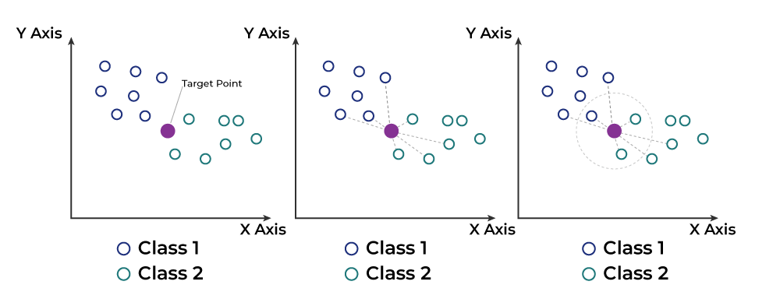
KNN
Step 1: Selecting the optimal value of K;
Step 2: Calculating distance;
Step 3: Finding Nearest Neighbors;
Step 4: Taking Average for Regression.

Slide 2
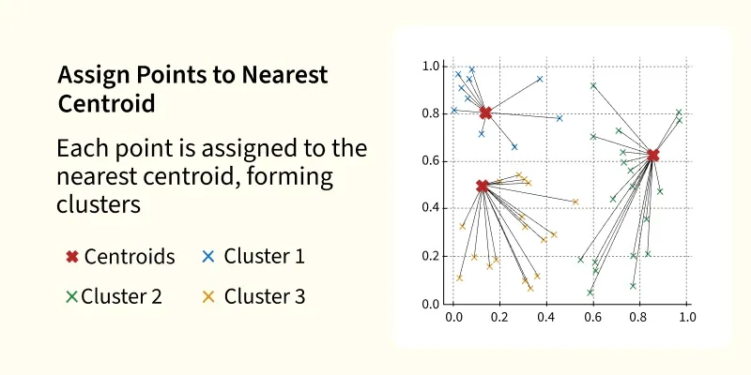

Slide 3
K-Means
K-Means Clustering groups similar data points into clusters without needing labeled data. It is used to uncover hidden patterns when the goal is to organize data based on similarity.

Slide 4
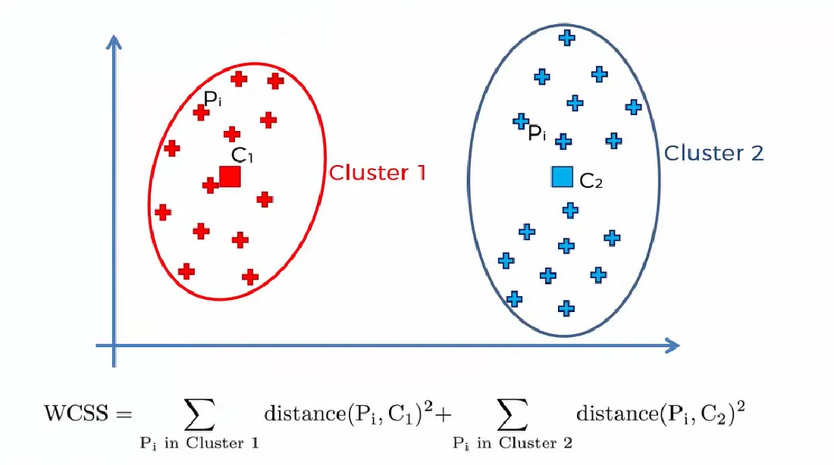
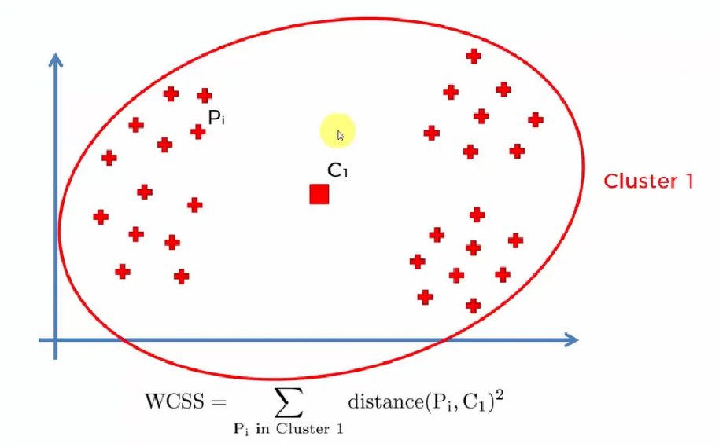
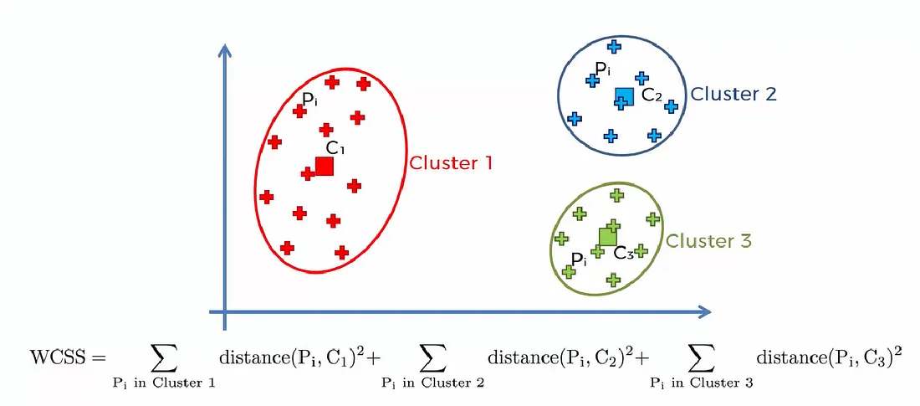
How does it work?

Slide 5
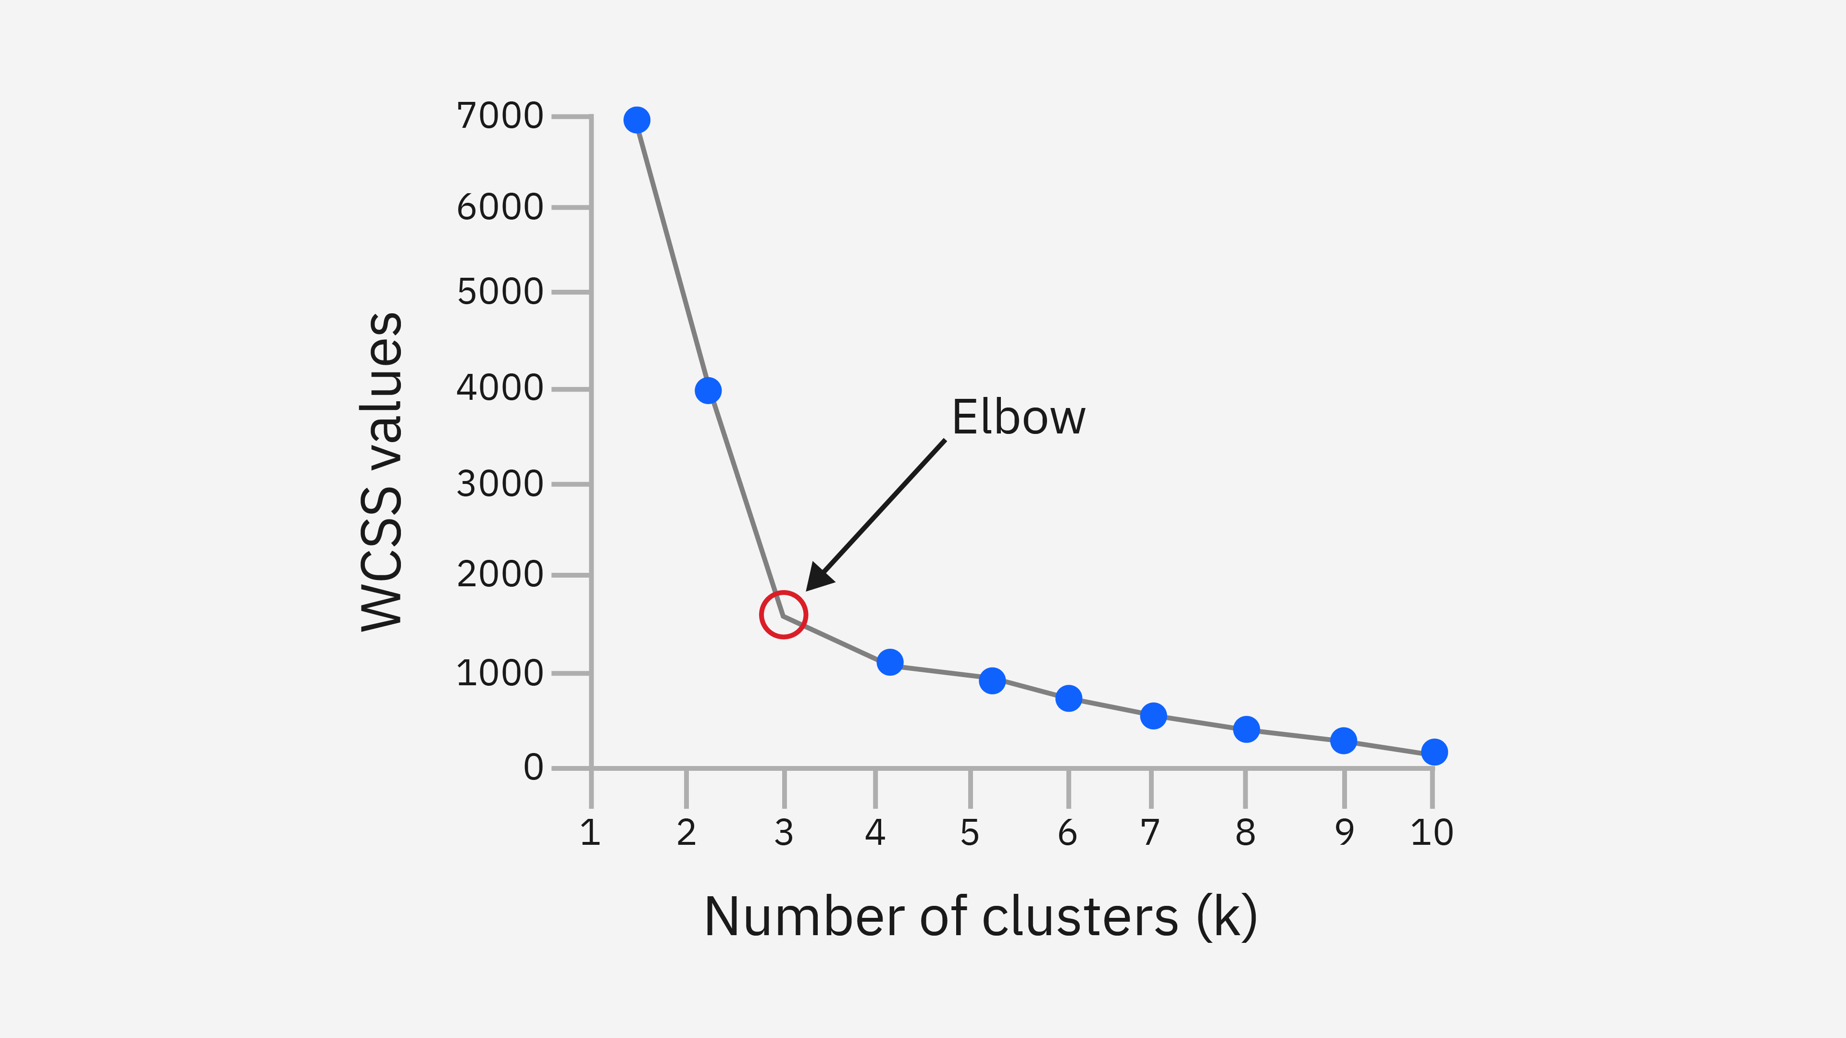
ELBOW Method

Slide 6
ELBOW Method
Correspondence analysis is a statistical methodology utilized for identifying and visualizing the hidden patterns and associations between categorical variables (Nominal and Ordinal) in multivariate data where variables have discrete categories rather than numerical values·

Slide 7
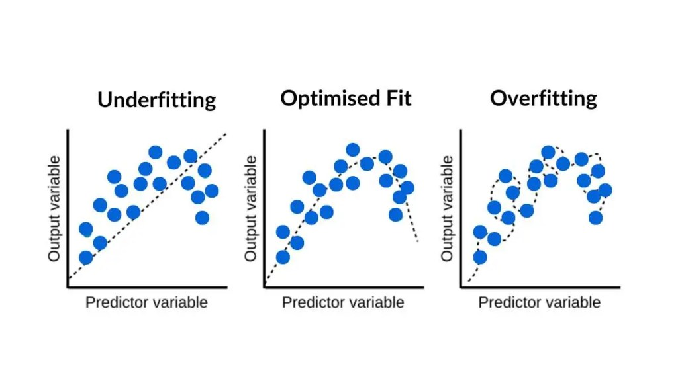
Ridge and Lasso

Slide 8
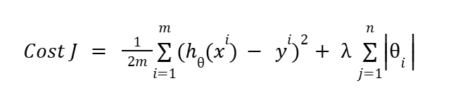
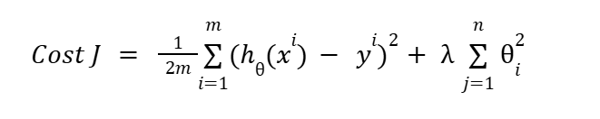
How to correct overfitting?
Lasso
Ridge

Slide 9
How to correct underfitting?
Optimize Hyperparameters
Clean your data
Features engineering

Slide 10
Machine Learning Techniques

Slide 11
Machine Learning Techniques
ML Techniques
Regularization
Bagging and Boosting
Cross Validation

Slide 12
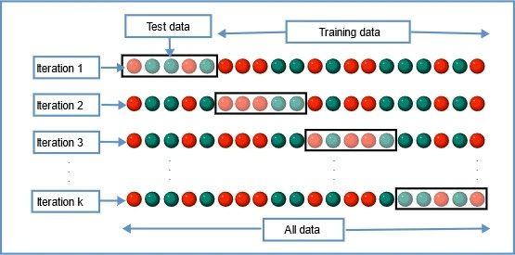
Cross Validation
Cross-validation is a technique used to check how well a machine learning model performs on unseen data while preventing overfitting. It works by:
Splitting the dataset into several parts.
Training the model on some parts and testing it on the remaining part.
Repeating this resampling process multiple times by choosing different parts of the dataset.

Slide 13
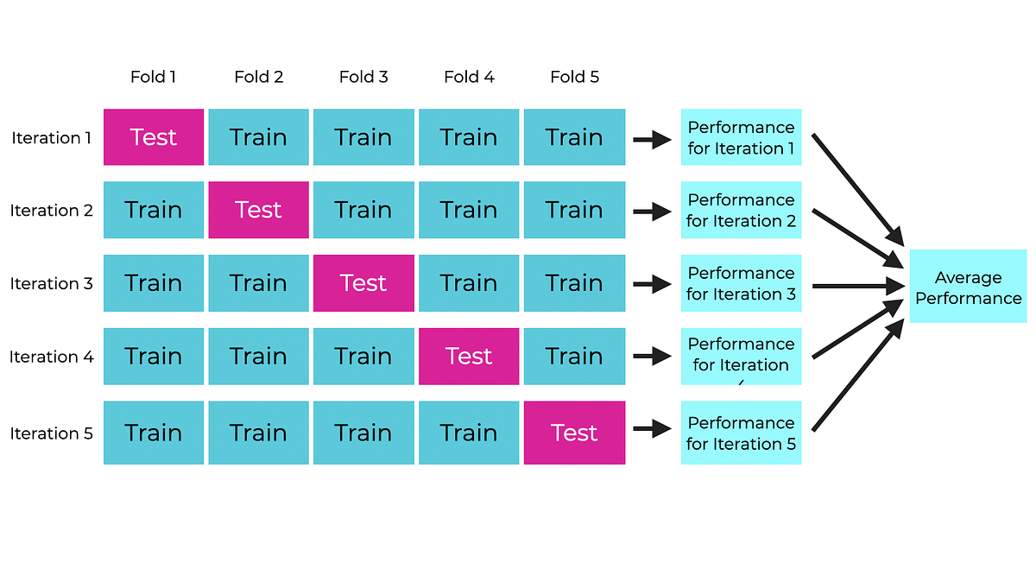
Types of Cross Validation
K-Fold
K-Fold Cross Validation splits the dataset into k equal-sized folds. The model is trained on k-1 folds and tested on the remaining fold. This process is repeated k times each time using a different fold for testing.
Disadvantages:
Low accuracy in case unbalanced data.

Slide 14
Types of Cross Validation
Stratified K Fold Cross Validation
Stratified K-Fold Cross Validation is a technique used for evaluating a model. It is particularly useful for classification problems in which the class labels are not evenly distributed i.e data is imbalanced. It is a enhanced version K Fold. Key difference is that it uses stratification which allows original distribution of each class to be maintained across each fold.

Slide 15
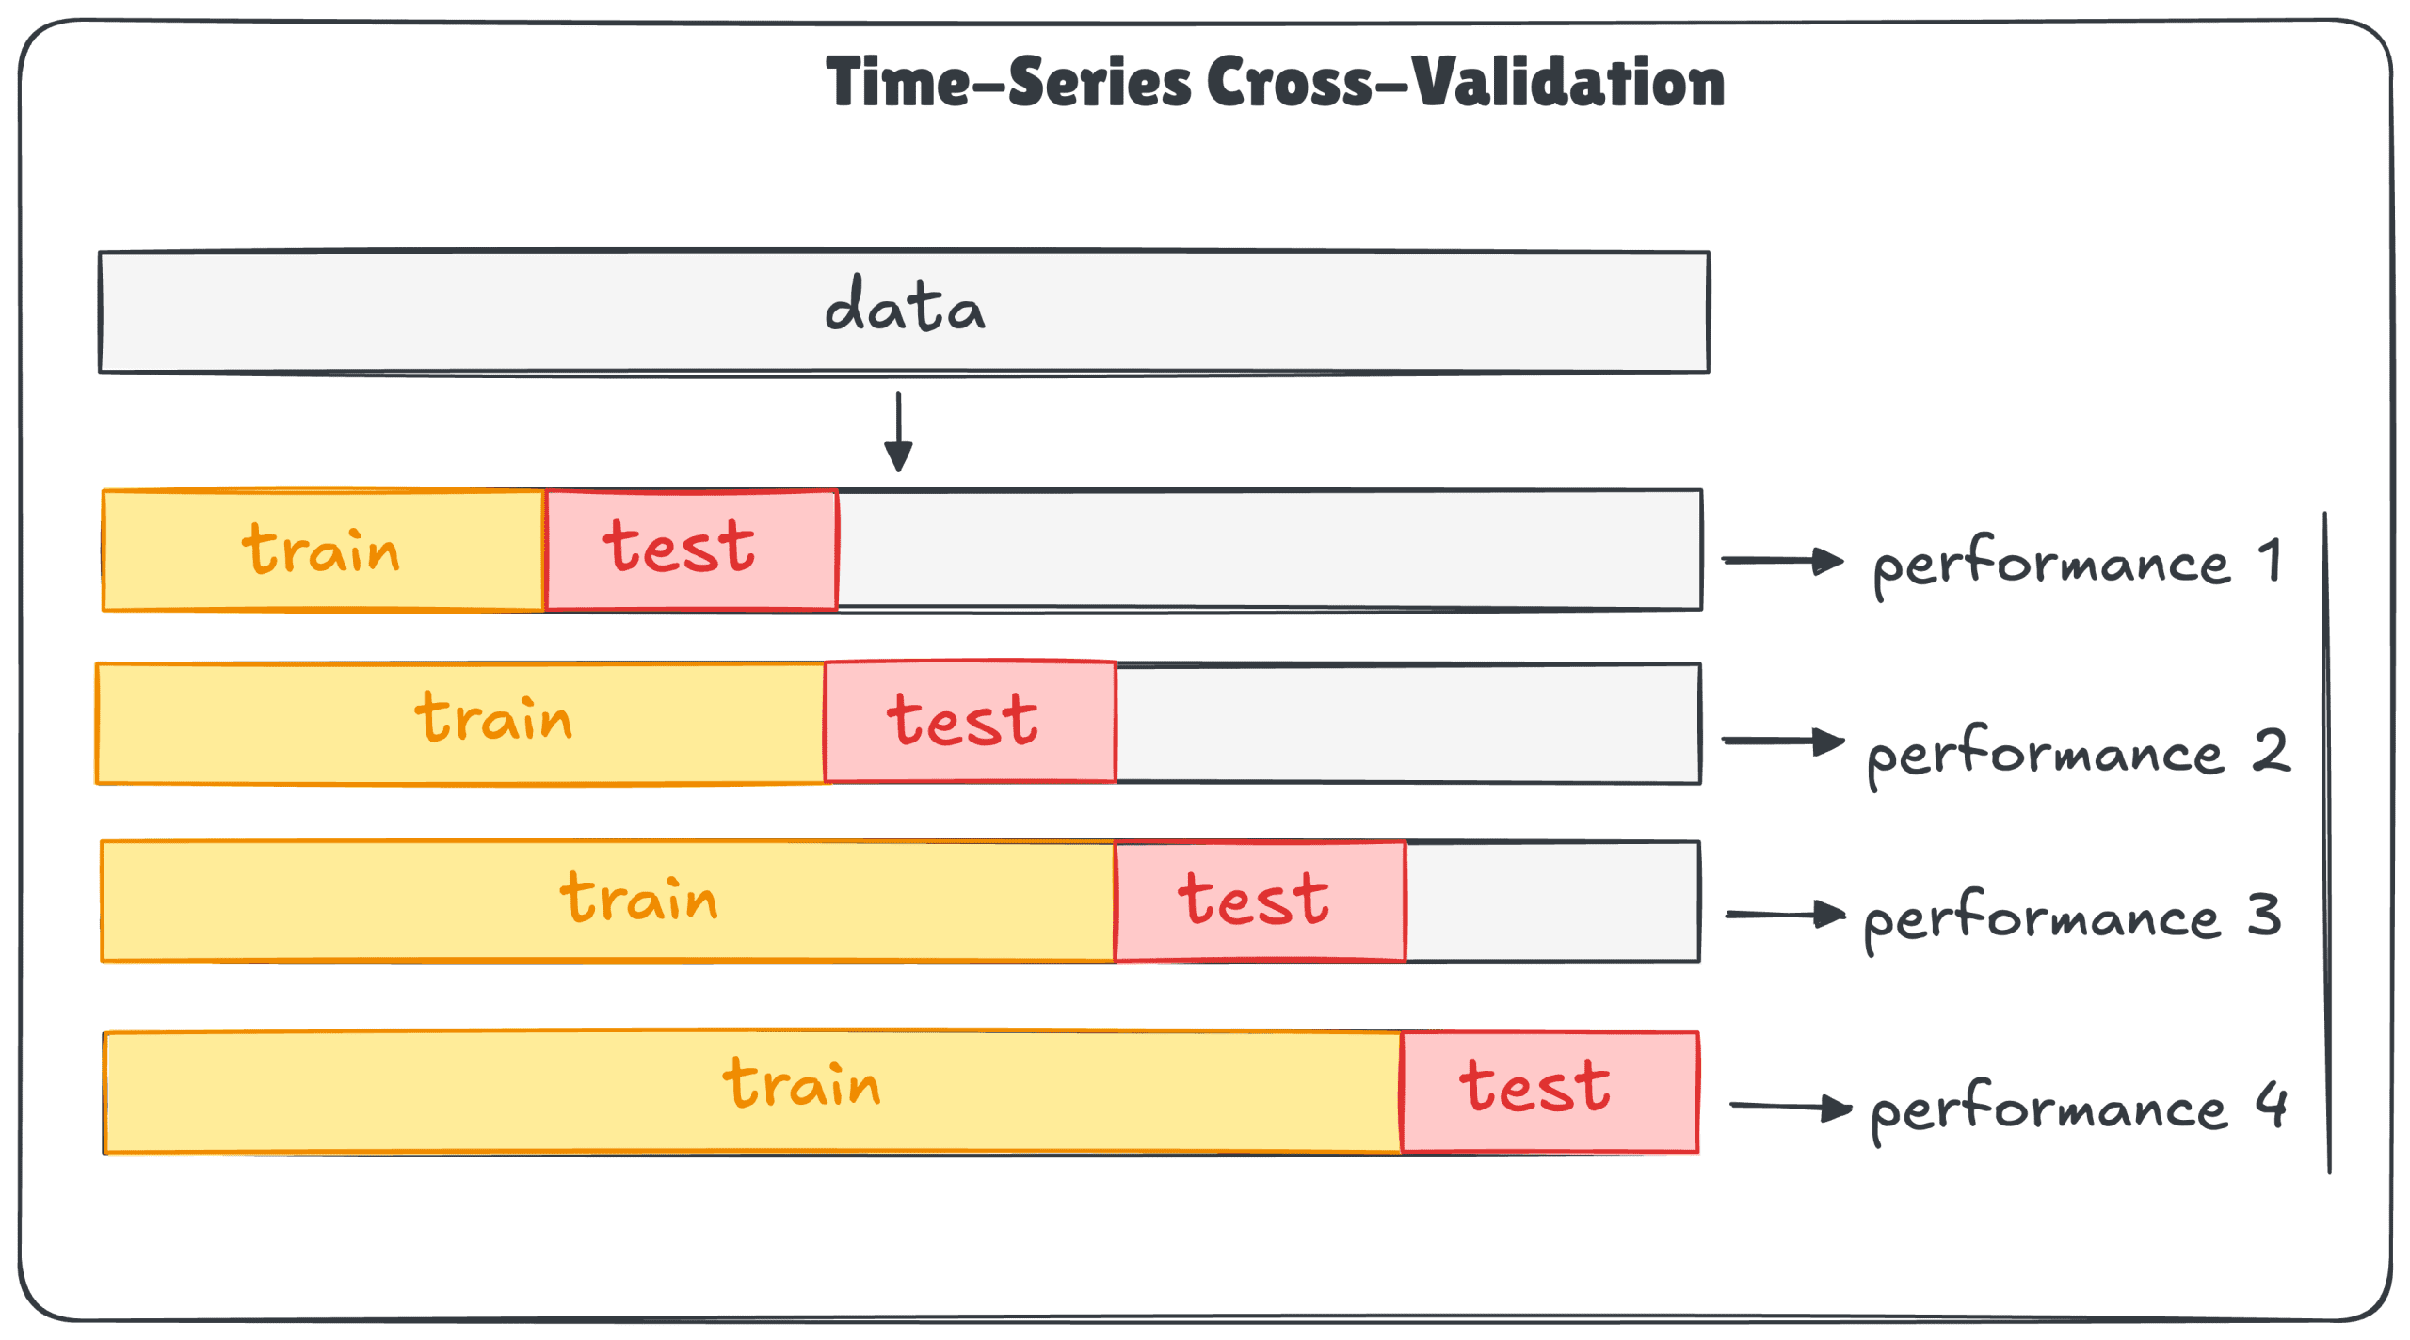
Types of Cross Validation
Time Series Cross Validation
Time Series Cross-Validation extends traditional cross-validation techniques to handle the temporal structure inherent in time series data. It ensures that the model is evaluated on past data and tested on future data, mimicking real-world scenarios.

